Slide 1
Managed Reinvention Services
Help CIOs deal reinvent tech economics - reduce cost and multiply productivity, to make a sharper capital allocation towards AI powered growth and experience.
Avinash Rao (Avi)
May 2026
CONFIDENTIAL & INTERNAL ONLY
Notes:
Deck Summary: Managed Reinvention Services — Accenture Digital Core, May 2026
1. Strategic Context & Market Forces
The traditional managed services model is structurally challenged — Gartner predicts 40% of enterprise applications will embed AI agents by end of 2026, and IDC forecasts 30%of service contracts will be outcome-based by 2029. Seat-based pricing is becoming obsolete.
CIOs face a "generational shift" driven by agentic AI reshaping work, workforce, and workbench simultaneously — yet ~70% of tech budgets remain locked in maintenance, leaving only 0.5 cents per dollar for building AI products.
The business expectation is captured as: "40% more change at 40% higher velocity and 40% lower cost — with same or lower headcount."
2. What Managed Reinvention Services Is
Core proposition — Help CIOs reshape tech economics by shifting Run spend to Reinvention capital, moving beyond traditional levers to a hybrid Agent + Human workforce.
Five pillars: Autonomous Operations, Frictionless Change, Continuous Simplification & Modernization, Business Domain Reinvention, and Technology Cost & Productivity Reinvention.
Target outcomes: 3–5× AI-driven enterprise velocity, 40–50% cost savings, and a 70% pivot to Reinvention from Run spend.
Five success factors for making it work: Context Grounding (via a Service Intelligence Context Graph as a living digital twin), Governance Guardrails, Human + Agent Interaction Model, Process Redesign, and a Compounding Value Mindset.
3. Platform & Autonomy Framework
Reinvention.AI is the underlying platform — an open, AI-powered system with an Enterprise Memory (Knowledge Graph), Agent Marketplace, Integration Hub, Control Tower, and Construct + AI Engine.
Autonomy levels range from L1 to L5: L1 (full human command) through L5 (full autonomy with a 5-minute human review window). Autonomy is earned, not assumed — bounded by the most restrictive constraint (e.g., PCI-DSS or safety-critical flags drop autonomy levels).
Autonomy-based pricing aligns commercial models with maturity: as autonomy increases, the commercial model shifts from FTE rate cards to outcome/value-based pricing with shared upside.
4. Solution Playbook & Delivery Model
Six-phase journey across ~47+ months: Phase 0–2 (Transition & Transformation, months 1–6) → Phase 3–6 (Agentic AI-Led Service Delivery, month 7 onward).
80+ agents across 3 domains and 9 sub-domains (App Management, App Development, Infrastructure), deployed progressively — copilot-first in early phases, fully autonomous by Phase 6.
Human/Agent ratios shift dramatically: App Management moves from 100% human to 20H/80A; Infrastructure from 100% human to 20H/80A; App Dev from 100% human to 30H/70A.
Value pools: Brilliant Basics → Agentic AI Ops → AI-Native SDLC → Tech Modernization, with agent resolution targets of ≥40% (Phase 3) → ≥90% (Phase 6) and cost reduction of 10% → 40–60%.
5. Risk Management
12 tracked risks with detailed mitigations, including Digital Brain data quality (CMDB accuracy ≥75% required before Phase 1), workforce adoption resistance, legacy integration barriers, LLM model drift, prompt injection attacks, and commercial model misalignment.
Critical shared commitments from both client and provider — executive sponsorship, data foundation readiness, outcome-based commercial alignment, and Responsible AI governance from Phase 0.
6. Client Case Studies
Global Logistics Major — $1.2B IT cost take-out, 37% annual tech spend reduction, 45–73% productivity uplift, and 94K incidents eradicated through Prometheus 1.0/2.0 automation-first operations.
BBVA (Banking) — 117% new customer growthover 5 years, €8B record profit, 65% digital channel acquisition, powered by cloud, AI, and digital CX reinvention.
7. Leadership & Go-to-Market
Global Lead: Avinash Rao, supported by market leads across Americas, EMEA, Japan, and APAC, with dedicated offering leads for Autonomous Operations, Tech Cost & Productivity Reinvention, Managed Capacity Services, and Reinvention.AI platform engineering.
Key Takeaways
This is a fundamental repositioning of managed services — from "your mess for less" cost arbitrage to a platform-driven, agent-first model that compounds value over time through a living digital twin.
The commercial shift is as significant as the technical one — autonomy-based pricing ties provider incentives to client outcomes, not headcount.
Execution hinges on five non-negotiables: data quality, governance, human-agent interaction design, process re-architecture, and sustained executive sponsorship from both sides.
The proof points are strong — billion-dollar outcomes at global logistics and banking clients lend credibility to the ambition.
Speed matters — the presentation frames this as an urgent, not optional, pivot, given how rapidly agentic AI is reshaping enterprise operations.

Slide 2
State of
Managed Services
May 2026
Notes:
Analyst quote

Slide 3
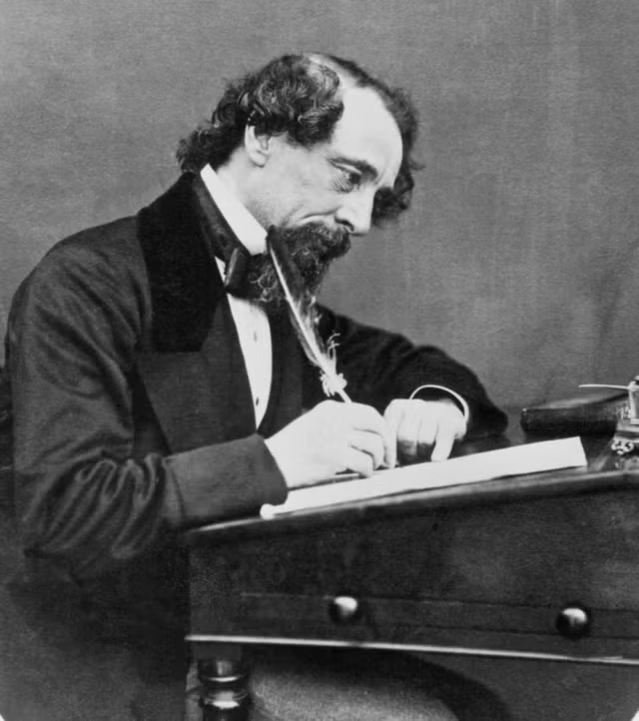
State of
Managed Services
"It was the best of times, it was the worst of times,
It was the age of wisdom, it was the age of foolishness,
It was the epoch of belief, it was the epoch of incredulity,
It was the season of light, it was the season of darkness,
It was the spring of hope, it was the winter of despair."
May 2026
Notes:
Analyst quote

Slide 4
State of
Managed Services
“Is AI a deflationary force to Managed Services?”
“Does AI as a platform shift represent the mother of all vendor consolidation opportunities?”
May 2026
“Is there an urgent need to proactively rotate our existing book of business?”
“Is this a unique moment to disrupt our competitor’s footprint with proactive offers?”
“Is it clear that we need a unique competitive platform-based moat?”
“Is it clear that our commercial models need to evolve?”
Notes:
Questions that represent the confusion

Slide 5
It is time to rewrite the playbook
Time to turn the page. And rotate to Managed Reinvention Services.
 | Traditional AMS | Run to New | Managed Reinvention Services
Value Prop | “Your Mess For Less" Cost arbitrage. Accept complexity as a given, optimise labour cost around it. | "Less Mess, More Change" Simplify, modernize and reduce tech debt while enabling more delivery throughput. | "Fuel for Reinvention" Reshape Tech Economics – shift Run spend to Reinvention capital.
Managing | Siloed application tickets and incidents; reactive, feature-by-feature. | Applications plus the underlying infra layer; broader scope, more leverage. | End-to-end value streams; Business outcomes, not just system uptime.
Workforce | Humans doing the work, with automation for repetitive tasks. | Humans augmented by Gen AI tooling, faster, but still human-in-the-loop. | Fleet of Agents + Human SREs operating with an Autonomous Operations mindset.
Platform | MyWizard: Automation and analytics tooling for AMS delivery. | GenWizard: Gen AI-native platform layered over MyWizard capabilities. | Reinvention.AI powered by a Service Intelligence Context Graph, a living digital twin
Bundled Value | None beyond keeping the lights on. | Resilience engineering, architecture simplification and modernisation, capacity release baked in. | Business Ops, Service Ops, Engineering Ops, Fin Ops, Security Ops, all bundled.
Outcomes | Productivity gains: FTE efficiency metrics. | Technology outcomes: Reliability, speed, platform health. | Business and technology outcomes: Revenue, Experience, Resilience, beyond SLAs
Commitment | Application availability SLAs | Service Level Agreements: SLOs tied to service performance. | Experience Level Agreements: Committed to the service quality users feel.
Commercial Models | T&M + human productivity; Pay for people and time. | Fixed price with Human + GenAI productivity; efficiency shared. | Outcome/Value with Subscription + Autonomy Based Pricing; Shared upside.
Competitive Position | More of the same: commoditised. | Differentiated; better tools, faster delivery, modern stack. | Compounding advantage; Platform evolves to be smarter with signal depth and scope breadth.
Internal Use Only

Slide 6
It is time to reframe how we approach our TAM
Time to turn the page. And rotate to Managed Reinvention Services.
DEFEND – PROTECT OUR SHARE
Re-platform the Run – before the client renegotiates the contract
Proactively rotate and renewal of our contracts
DISRUPT – INCREASE OUR SHARE
With every platform shift, comes consolidation opportunities - generational opportunity to make and take the market
Own the platform control point, consolidate the work on top of the platform
NEW VALUE POOLS – GROW THE MARKET
As AI builds more code and agents proliferate the enterprise, the level of technology complexity in our client estate is poised to explode.
Managed Services for AI, agents, data products and living ontologies
Internal Use Only

Slide 7

For CIOs, this moment is the most consequential and demanding of their career
Three converging forces – all raising the expectations of how the CIO responds
Navigating an uncertain macro economic climate
    Our clients are working in an increasingly recessionary environment, and are taking active measures to proactively review the cost and productivity of their organization
    Leading through a generational shift in Enterprise Tech
    Everything in Enterprise Tech is changing simultaneously – a new way of working (AI powered SDLC & ITIL), a new workforce (Human + Agents) and new workbench (Emerging Tech)
    Rapidly rising business expectations
    Expectation of “40% more throughput at 40% higher velocity at 40% lower cost – with the same or lesser headcount”. Democratized understanding of AI possibilities is challenging every aspect of a CIO’s job.
Internal Use Only
Notes:
Work backward from client reality

Slide 8
CIOs cannot meet the rising expectations without reinventing Tech Economics
Need to shift capital away from managing the past and delivering for today – and towards future aligned capabilities
For every $ 1 spent on Technology*…
…of which, 60 c is spent on Change
…of which, 30 c is spent
on discretionary change
…of which, 15 c is spent
on strategic applications
…of which, 3 c is spent
on software engineering
…of which, 0.5 c is spent
building AI Products & Services
$1
60 c
30 c
15 c
3 c
0.5 c
12 c
2.5 c
15 c
Opportunity to shift Run spend to Reinvention capital
30 c
40 c
Internal Use Only
* Global Retail Bank
Notes:
Work backward from client reality

Slide 9
Managed Reinvention Services: Shift Run spend to Reinvention capital
Help CIOs reshape tech economics by shifting Run spend to Reinvention capital. Go beyond the traditional levers - and move to a platform powered managed service with a hybrid Human + Agent workforce.
Technology Cost & Productivity Reinvention
Autonomous
Operations
Frictionless
Change
Continuous
Simplification & Modernization
Business Domain Reinvention
Reimagine Work
AI Powered SDLC and ITIL
AI First Operating Model
+
Reshape the Workforce
Fleet of Agents & SREs
New Role and Skills Framework
Reinvention.AI - Service Intelligence Platform
+
Redesign the Workbench
Powered by Reinvention.AI
Service Intelligence Context Graph
Future Talent Academy
Business and Technology outcomes:
40% - 50%
Cost savings
3-5X
AI-driven enterprise velocity
70%
Pivot to Reinvention from Run v/s 30%
Internal Use Only
Notes:
Work backward from client reality

Slide 10

What drives Accenture’s differentiation
Managed Reinvention Services
Platform Powered Managed Services
    Agents are commodity, models have relative parity – the true differentiation in a brownfield enterprise comes from capturing, curating and gardening the enterprise context via a platform that compounds value. Accenture assets (Reinvention.AI Service Intelligence Platform, GenWizard) driving speed to value.
    New frontiers of productivity with Human + Agent workforce
    Higher and front-loaded productivity curve. New commercial models with Autonomy Based Pricing and Platform Subscription models.
    Business outcomes, not just technology SLAs
    Experience level agreements for end-to-end business value streams, not just SLAs for technology availability.
Notes:
The "March of Nines" is a concept from reliability engineering describing the exponential difficulty of increasing a system's success rate. Popularized in the AI and self-driving car industries, it highlights that every additional "nine" of reliability requires as much engineering effort as all the previous levels combined.
www.superagent.sh +2
The Breakdown of the Concept
The First Nine (90%): This is the easiest milestone to achieve. It represents a strong, functioning demo where the main features work, but it is entirely inadequate for safe, real-world deployment.
www.superagent.sh +1
The Second & Third Nines (99% to 99.9%): Getting to these levels is a slog. Developers must hunt down, program, and patch rare corner cases. The cost of fixing errors skyrockets, meaning "mostly working" essentially means "definitely breaking" in production.
Medium·Maxwell Andrews +2
The Demo-to-Product Gap: Moving a project from an impressive prototype to dependable, production-grade software (such as achieving 99.999% "five nines" uptime) typically takes years.
www.superagent.sh +1

Slide 11
Demo
Click here
Notes:
Work backward from client reality

Slide 12
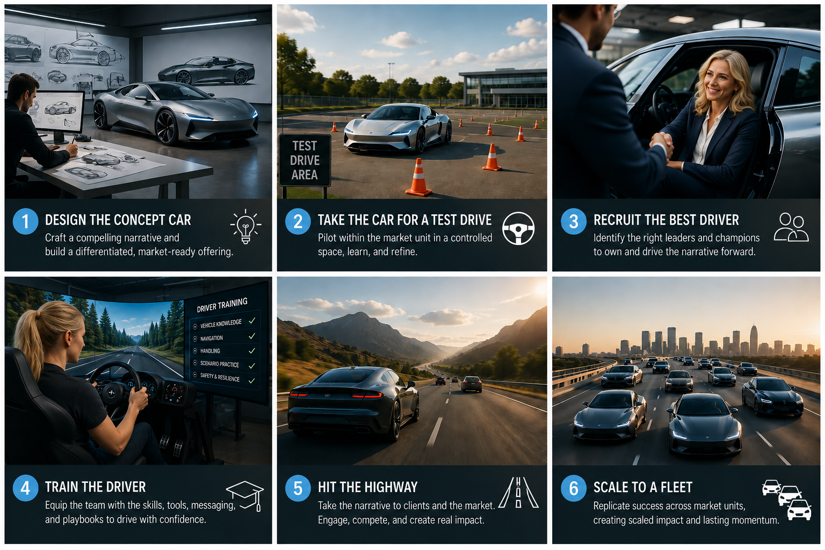
Call to action: Elevating the importance and rigor on ‘Defend and Disrupt’
Scaling this in each MU / CG will require us to take a whole of firm approach, recruiting the MU / CG Lead to the mission
We are standing up a new Managed Reinvention Services capability at a MU / CG level to move at scale and at speed – this is not a +1 job
We need to recruit the whole of the firm to get behind Defend and Disrupt – starting with the MU / CG leadership
Key measures of success as of 1st September:
FY27 Qual and UnQual Pipe
Q1’27 Qual Pipe
FY27 Mega pipeline
Notes:
Work backward from client reality

Slide 13
Appendix
Managed Reinvention Services
May 2026
CONFIDENTIAL & INTERNAL ONLY

Slide 14
Reinventing Managed Services is no longer optional
Three converging forces are making the traditional managed service model structurally challenged
Agentic AI is reshaping enterprise operations
Gartner predicts 40% of enterprise applications will embed task-specific AI agents by end of 2026, up from less than 5% today. IDC Future Scape 2026 forecasts that 40% of all G2000 job roles will involve working with AI agents this year - redefining every layer of the organization.
The Managed Services mandate has fundamentally changed
IDC's Future Scape: Worldwide Services 2026 identifies the 'agentic pivot' — a stage where AI shifts from experimentation to orchestration. Service providers must now redesign delivery around intelligence, automation and measurable outcomes - not headcount and ticket volumes.
40%
70%
30%
30x
Commercial models must follow or become irrelevant
      IDC predicts that by 2028, pure seat-based pricing will be obsolete as AI agents replace manual labor. By 2029, 30% of all service provider contracts will be outcome-based. A managed service priced on time and materials is fundamentally misaligned with where enterprise buyers are heading.
of G2000 roles will involve AI agents
of vendors must refactor pricing models
of contracts will become outcome based
growth in enterprise AI agents deployed by 2029
IDC Future Scape 2026
IDC Future Scape 2026
IDC Worldwide Services 2026
Gartner 2026
Internal Use Only

Slide 15
Managed Reinvention Services
Managed Reinvention Services helps client CIOs, CTOs and CDOs modernize and manage their digital foundations—across applications, infrastructure, AI and data, platforms and cloud. We help CIOs reinvent tech economics – reduce cost and multiply productivity, to make a sharper capital allocation towards AI powered growth and experience.
Internal Use Only
Notes:
Digital Core helps client CIOs, CTOs and CDOs reinvent their digital foundations—including technology strategy and architecture, data and AI, modernizing and managing applications, infrastructure, data and cloud. We build an industry-aligned digital core for clients to be an AI-enabled enterprise, driving measurable business value at speed and scale.
Managed Reinvention Services helps client CIOs, CTOs and CDOs modernize and manage their digital foundations—across applications, infrastructure, AI and data, platforms and cloud.
We help CIOs reinvent tech economics - reduce cost and multiply productivity, to make a sharper capital allocation towards AI powered growth and experience.

Slide 16
Global Offering Lead: Avinash Rao
Digital Core Offering Domain
Managed Reinvention Services: Strategic snapshot & offering architecture
CLIENT PROFILE | CLIENT PERSONAS CIO, CTO, CDO, Chief AI Officer, Chief Platform Officer, Chief Procurement Officer | CLIENT PRIORITIES Reinvent cost and productivity now Reallocate capital toward an AI‑powered growth and experience Use AI and agents to tame complexity
TAM | Tech Services – AMS: $100+B in 2025 at 4.5% CAGR
GROWTH AMBITION | 7% growth ambition Grow New Skills New (forward deployed engineers to build Service Intelligence Context Graphs) MD&I for Reinvention.AI platform, New Commercial models (autonomy-based pricing)
WHAT DO WE WANT TO BE KNOWN FOR | Be the go-to partner for CIOs looking to deal with burgeoning complexity and reinvent Tech Economics – reduce cost, multiply productivity and reallocate capital towards AI powered growth and experience Rewrite the playbook for Managed Services – Be the go-to partner for enterprise grade (safe and controlled) Managed Services which is Agent First with Human in the Lead.
SUB OFFERINGS (L3)
1. | 2. | 3. | 4. | 5.
Tech Cost & Productivity Reinvention: Reinvent technology organizations for the AI era – achieving new performance frontiers of cost, productivity and capability. | Managed Reinvention Services – Autonomous Operations for Applications & AI Agents: AI First Managed Service powered by Reinvention.AI’s Service Intelligence Context Graph | Managed Reinvention Services –Autonomous Operations for Platforms, Infrastructure, Data*: AI First Managed Service powered by Reinvention.AI’s Service Intelligence Context Graph | Managed Reinvention Services – Application Development & Quality Engineering: AI First Capacity Services to deliver App Dev Change and Quality Services | Managed Reinvention Services – Modernization & Simplification*: AI First continuous architecture modernization and simplification powered by Reinvention.AI’s Service Intelligence Context Graph.
GROWTH AREAS
EXPAND THE CORE Defend core incumbent deals Disrupt competition’s multi-tower deals Integrated Apps and Infra Managed Capacity Services Managed Modernization and Simplification | GROW THE NEW Managed Reinvention Services – Agent first with Human in Lead Managed Reinvention Services – AI, Agents, Data Products and Ontologies AI First Sourcing Partnerships to proactively drive vendor consolidation
PRIORITY INDUSTRIES
All Industries
BUSINESS VALUE
REDUCED IT Run Cost | TCO savings | IMPROVED Business Resilience | ENHANCED Business Experience | IMPROVED Velocity | TRANSFORMED Talent
* part of the respective Software & Platform Engineering, AI-ready Data, and Intelligent Infrastructure Services Offering Domains. Integrated within the larger Managed Reinvention Services framework as an offer depending on scope for a multi-tower deal.
Internal Use Only
Copyright © 2026 Accenture. All rights reserved.
16

Slide 17



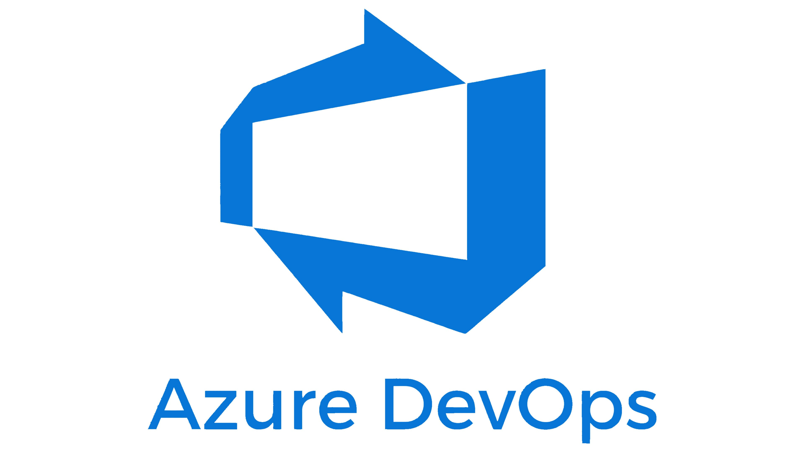
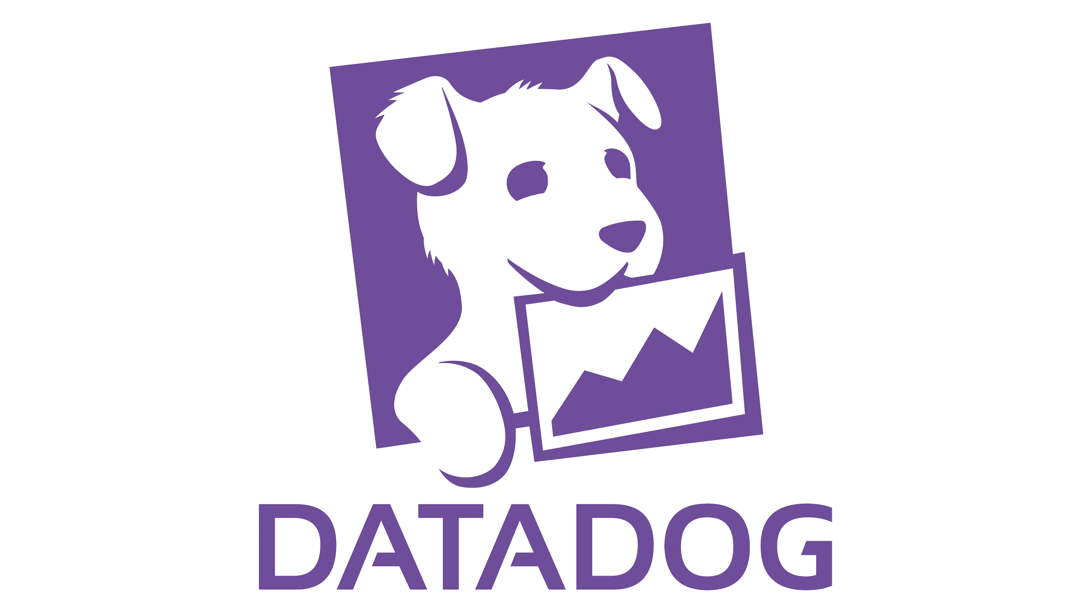



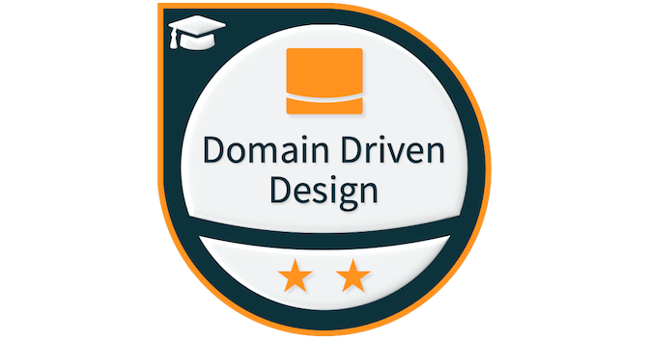


Managed Reinvention Services – Service Intelligence Platform
Agent First, Human In the Lead and powered by a living digital twin of the client’s estate via Service Intelligence Platform
Human SREs
Continuous Simplification & Modernization
AI First Managed Services
Autonomous Operations
Frictionless Change
Business Domain Reinvention
Agent Marketplace
Payment Service Threshold Breach Signal
Agent triaged and traced to Application A
Managed by shared Infrastructure B
Deployed by Team D
Service Intelligence Context Graph (Enterprise Memory asset that compounds value)
Raise Problem record
Update Agent Memory
Triggers Incident Ticket
Likely caused by Release C
SRE confirmation + Initiate roll back procedure
AI Normalisation & Inference layer
Entity Resolution
Edge Inference
Agentic Ops Controls
Provenance Tracing
Human In Lead Confirmation
Schema Mapping
Confidence Scoring
Explainable Audit Logs
Confidence Transparency
Integration Hub: Signal sources from client’s brownfield estate
Code Repos
CI / CD Pipelines
CMDB/ Service Mgmt.
Observability
Wiki / Docs
Team Topology
Domain Driven Design
Financials
Internal Use Only
Notes:
Digital Core helps client CIOs, CTOs and CDOs reinvent their digital foundations—including technology strategy and architecture, data and AI, modernizing and managing applications, infrastructure, data and cloud. We build an industry-aligned digital core for clients to be an AI-enabled enterprise, driving measurable business value at speed and scale.
Managed Reinvention Services helps client CIOs, CTOs and CDOs modernize and manage their digital foundations—across applications, infrastructure, AI and data, platforms and cloud.
We help CIOs reinvent tech economics - reduce cost and multiply productivity, to make a sharper capital allocation towards AI powered growth and experience.

Slide 18

Managed Reinvention Services – Reinvention.AI
Service Intelligence Platform
Reinvention.AI
Unified, AI-powered platform to accelerate reinvention for clients
Ecosystem Assets & Knowledge
Partner tools & solutions
Construct + AI Engine
Interactive journey builder to construct client tailored reinvention journey
Accenture Assets
Integrate
ART
GenWizard
SynOps
Marketplace
Capabilities & Assets
Asset Registry & Catalog
Ecosystem Assets
Accenture Internal Assets
Client Assets
ARC / other assets
Enterprise Memory
Context & Knowledge
Graph
Ontologies
Short & Long-term Memory
Episodic Memory
Control Tower
Measure, monitor, and govern outcomes
Observability & Control Tower
Real-time KPI tracking
Outcome monitoring
Instrumentation & Analytics
Digital Twin
UMP
…
Reinvention.AI Engine
Orchestrate
Accenture Reinvention Construct
Contextualize
Curated Assets Gallery
Integration Hub
Connecting systems, assets, data, and agents
Asset integration
Modular platform asset integration
Data flow & Lifecycle management
Asset interoperability
Agentic Mesh
Accenture Digital Brain
Intelligent Data Foundation
Specialized Models
Industry Agent Ensemble
…
Internal Use Only
Notes:
Digital Core helps client CIOs, CTOs and CDOs reinvent their digital foundations—including technology strategy and architecture, data and AI, modernizing and managing applications, infrastructure, data and cloud. We build an industry-aligned digital core for clients to be an AI-enabled enterprise, driving measurable business value at speed and scale.
Managed Reinvention Services helps client CIOs, CTOs and CDOs modernize and manage their digital foundations—across applications, infrastructure, AI and data, platforms and cloud.
We help CIOs reinvent tech economics - reduce cost and multiply productivity, to make a sharper capital allocation towards AI powered growth and experience.

Slide 19
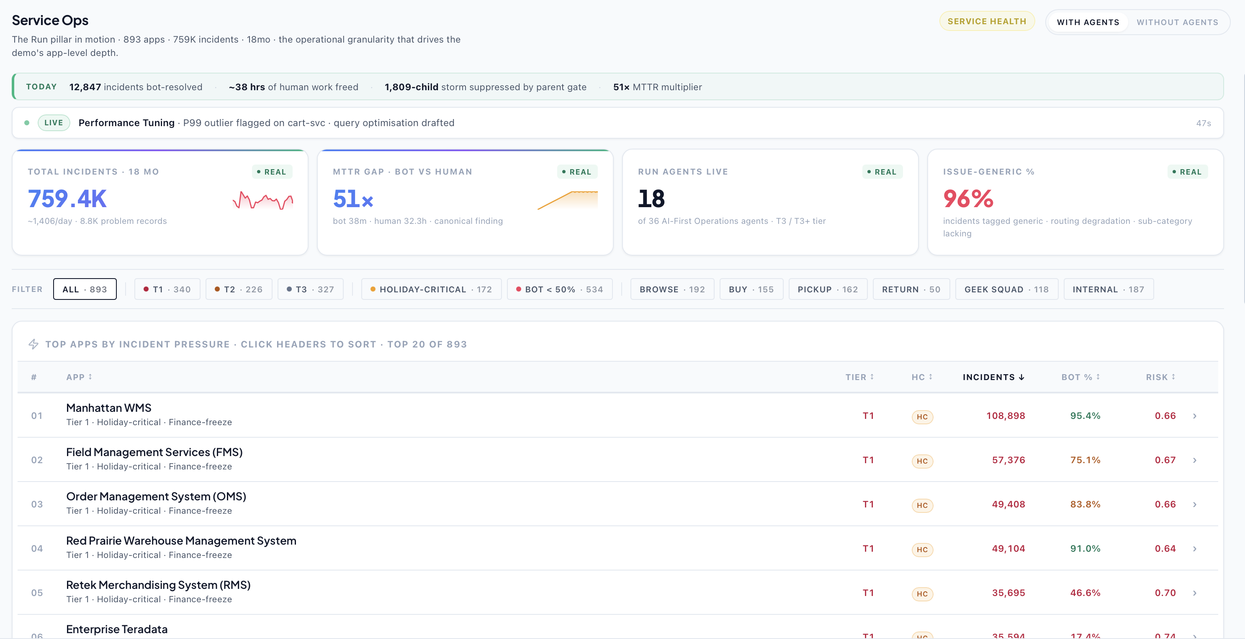
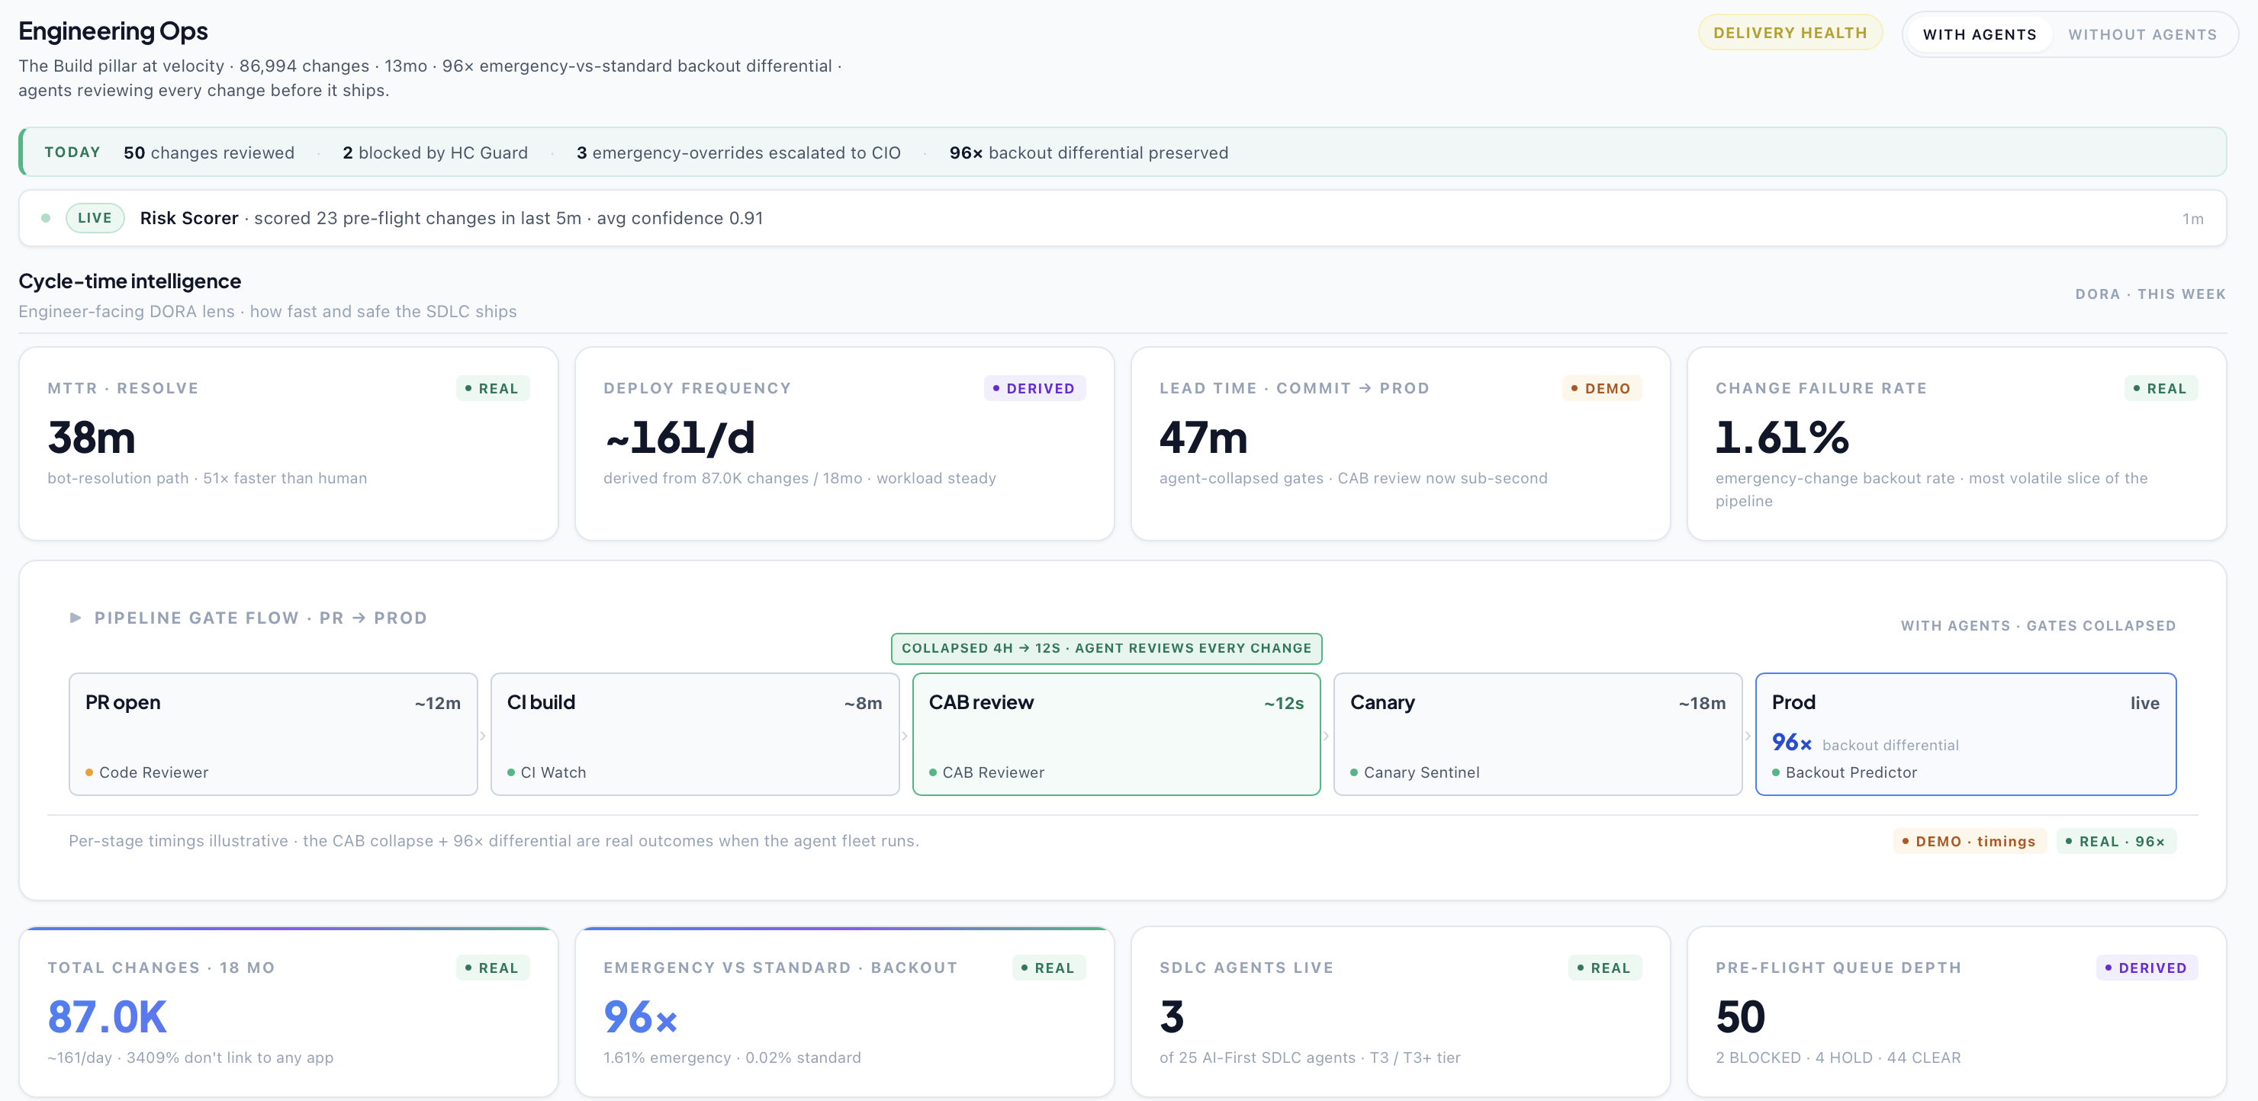
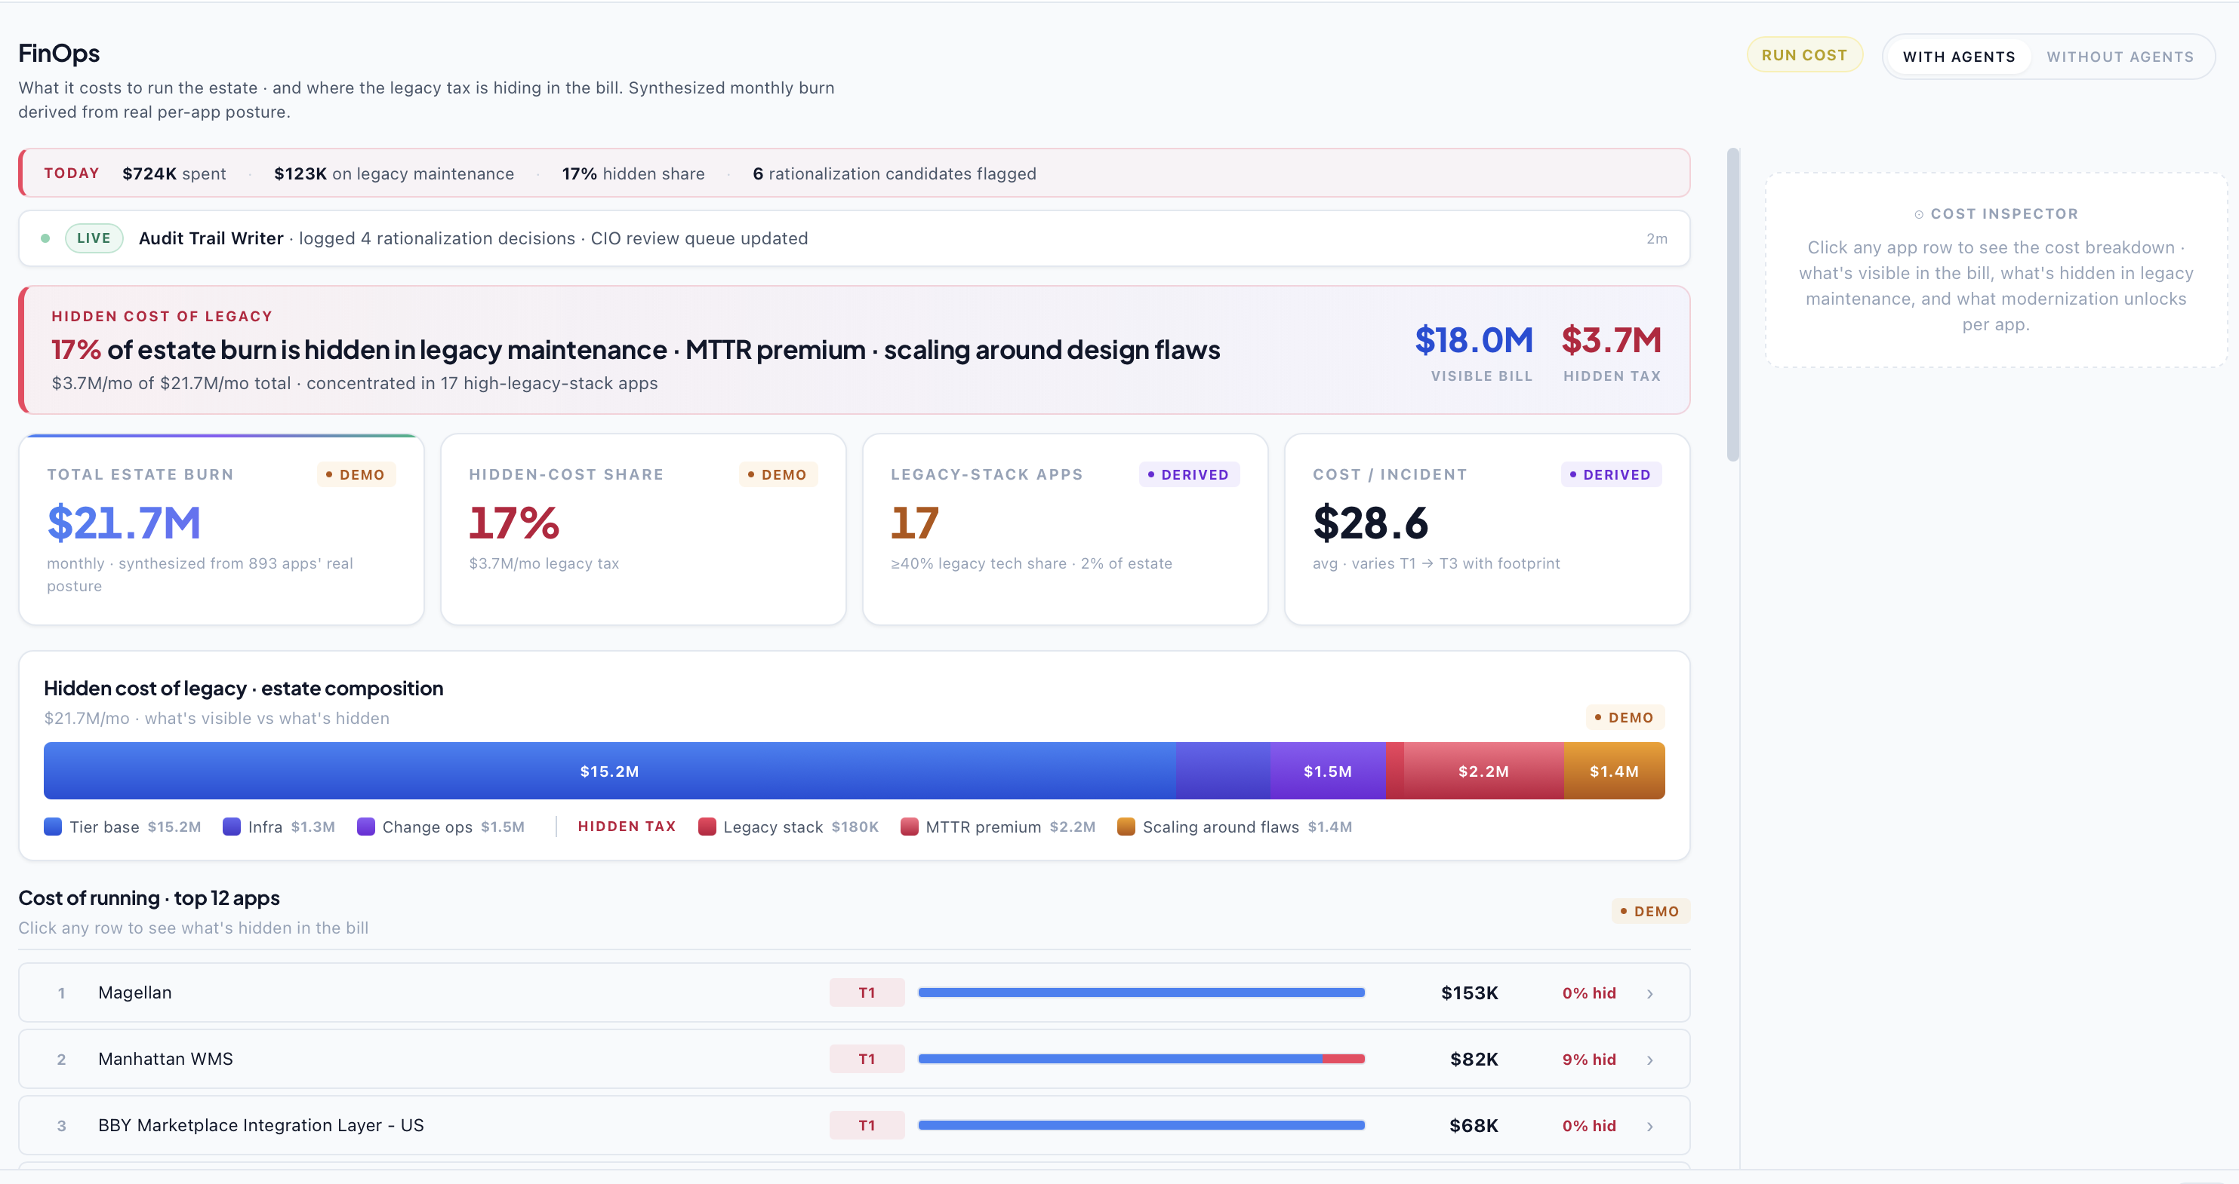
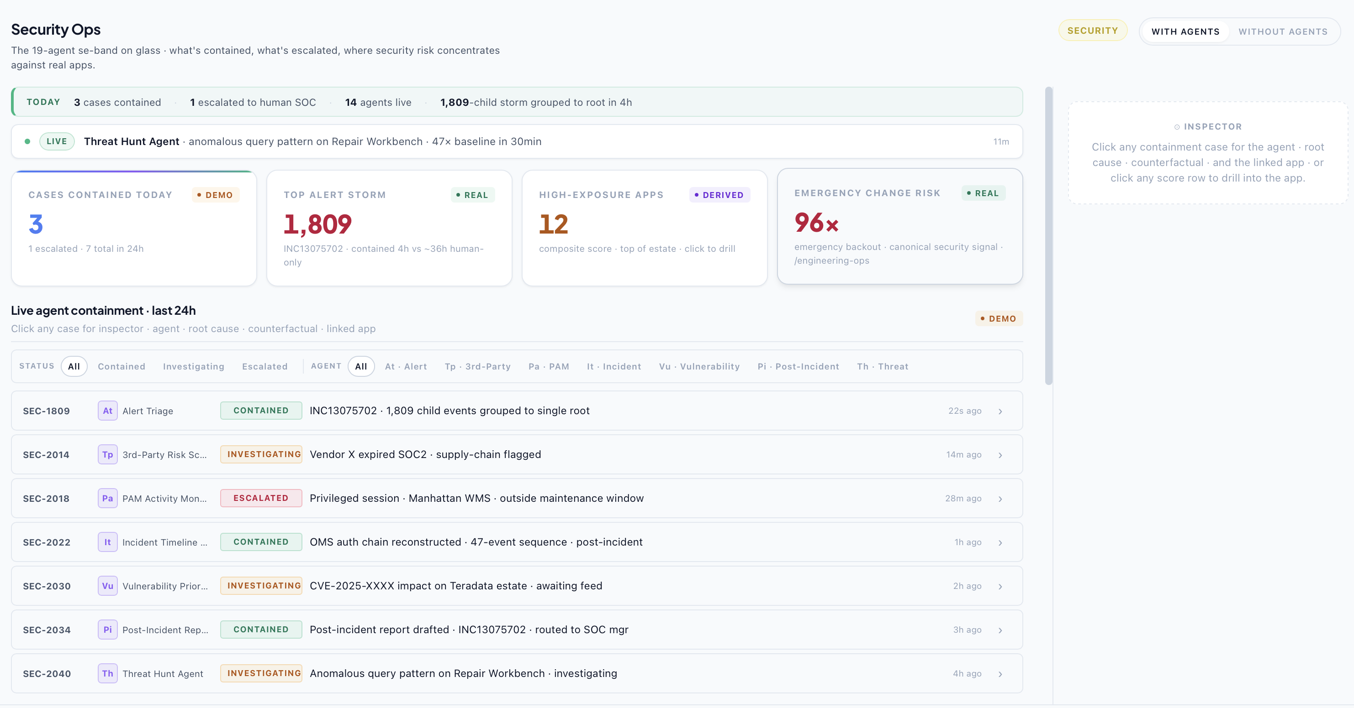
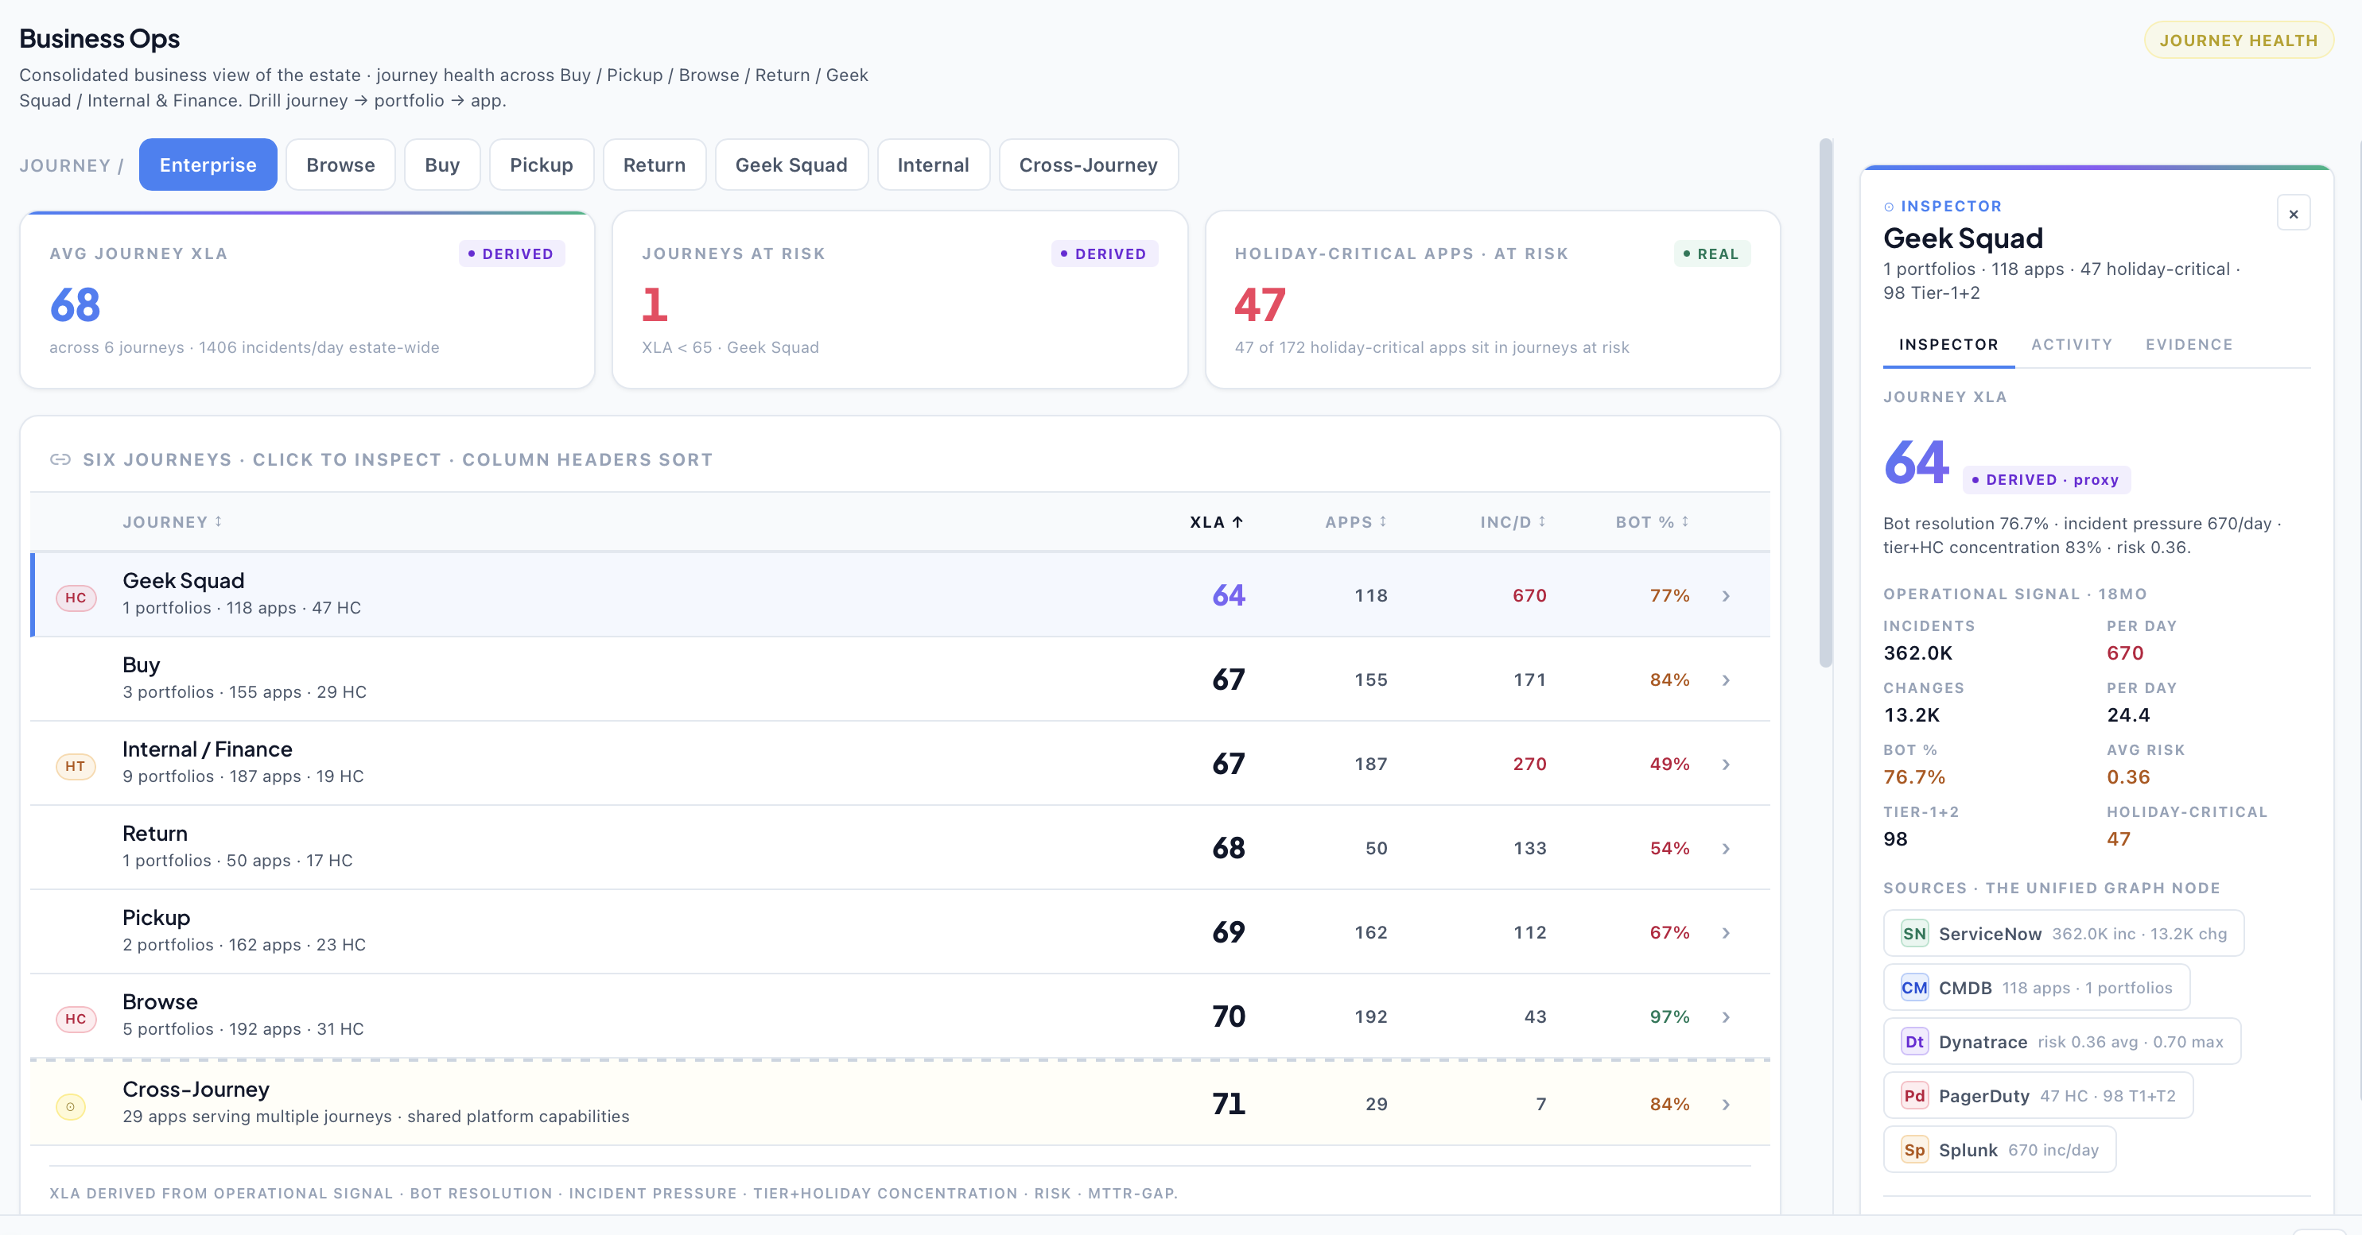
Managed Reinvention Services – Client outcomes
Click here for demo
Service Ops: From Operator to Orchestrator
Service stability and resilience traceability for end-to-end value streams
Engineering Ops: From Engineer to Director
Time to market and change quality for end-to-end value streams
Security Ops: From Guardian to Governor
Mean time to detect and resolve for end-to-end value streams
Financial Ops: From Financial Stewart to Value Architect
Cost transparency and value traceability by end-to-end value streams
Business Ops: From Service Manager to Experience Architect
Industry specific experience level agreements (XLAs, not just SLAs) for end-to-end value streams
Internal Use Only
Notes:
Digital Core helps client CIOs, CTOs and CDOs reinvent their digital foundations—including technology strategy and architecture, data and AI, modernizing and managing applications, infrastructure, data and cloud. We build an industry-aligned digital core for clients to be an AI-enabled enterprise, driving measurable business value at speed and scale.
Managed Reinvention Services helps client CIOs, CTOs and CDOs modernize and manage their digital foundations—across applications, infrastructure, AI and data, platforms and cloud.
We help CIOs reinvent tech economics - reduce cost and multiply productivity, to make a sharper capital allocation towards AI powered growth and experience.

Slide 20
Managed Reinvention Services - Solution playbook
TRACK /
WORKSTREAM
TRANSITION & TRANSFORMATION · Platform Build · Months 1–6 · Phases 0–2
⚡ AGENTIC AI LED SERVICE DELIVERY · Month 7+ → Ongoing · Phases 3–6
M 1–2
M 3–5
M 6
M 7–18
M 18–30
M 30–47
M 47+
Ph 0
Ph 1
Ph 2
Ph 3
Ph 4
Ph 5
Ph 6
Transition /Foundation
Configure & Integrate
Validate & Pilot
AI-Augmented Ops
Agentic
Semi-Autonomous Ops
Fully Autonomous Ops
H/A RATIO BY DOMAIN
App Dev
95% H
95% H
95% H
80H/20A
60H/40A
40H/60A
30H/70A
App Mgmt
95% H
95% H
95% H
75H/25A
50H/50A
35H/65A
20H/80A
Infra
95% H
95% H
95% H
70H/30A
50H/50A
35H/65A
20H/80A
AGENTIC PLATFORM FOUNDATION
Agentic Eng
+ Observability
Plan/Assess
Architect
Configure
Operate · Monitor · Evolve
Scale &
Sustain
Self-Optimise
24×7
Digital Brain
+ PVE (ITIL)
PVE Explore + DB Capture/Collect
Digital Brain
Setup
DB Continuous Enrichment + Agent-First ITIL Active
Agent Studio
(Build & Scale)
Plan/Assess
Deploy ITSM+TDLC+ AIOps Agents
Scale &
Domain Specific
Scale &
Sustain
Setup/Build/ Configure
Scale &
Sustain
Factory Scale · On-demand Agent Provisioning
KNOWLEDGE TRANSITION
Knowledge
Journey
Joint Planning + Gap Assessment
Knowledge Ingestion + DB Gap-Fill KT
Enrichment + Simulation Ongoing
Continuous Enrichment · Autonomous KB
SERVICE DELIVERY — VALUE POOLS
VP1
Brilliant Basics
Gap
Assessment
IaC+Config Setup
+SRE Deploy
Autonomous Patching
+SRE Active
Self-Healing Infra
+Drift Detection
Zero-Touch Ops
+Proactive Remediation
Autonomous Resilience
+Self-Healing 24×7
VP2
Agentic AI Ops
Foundation Build
· Brilliant Basics
AI-Assisted (L2) Incident Automation, Deploy AIO Ops agents 80% of Ticket volumetrics
AI-Augmented (L3)
Change+Problem Mgmt
Semi-Auto (L4)
Predictive+Preventive
Autonomous (L5)
Zero-Touch AIOps
VP3
AI Native SDLC
AI Toolchain+
Codebase Indexing
Copilot-First Dev
+AI Test Gen+CI/CD
1.5× Velocity
+AI Agents Pilot
Code Agents
+Auto QA · 3-4×
Agentic Squads
+Sprint Automation
Semi-Auto 5-6×
Sprint Orchestration
Fully Auto
7-10× Productivity
VP4
Tech Modernisation
Tech Debt &
APR Assessment
Modernization
Roadmap+Plan
Pilot
Modernization
APR Execution
+Cloud Migration
Agentic-Led
Modernization
Continuous Tech
Stack Evolution
Autonomous
Modernization+APR
OPERATING MODEL & TRANSFORMATION
Operating Model
+ BPR
Strategy &
Planning
Interaction
Model Design
Communication
& Training
Implementation+BPR
+Business KPI Monitoring
Continuous BPR · Value Chain Optimization
Change Mgmt
(Human+Agent)
Strategy
Communication
& Engagement
Training &
Capability
Implementation
& Support
Sustainment &
Reinforcement
Embed & Sustain · Culture of Autonomous Ops
GOVERNANCE · RESPONSIBLE AI · SECURITY · VALUE REALIZATION
Governance
& Reporting
Setup VRO
+Demand Tracker
Transition
Reporting
Management & Reporting
+Value Tracking
Continuous Governance · Autonomous Value Optimization
RAI + Security
+ Value
RAI Strategy
+Security Plan
Establish RAI
+Compliance
RAI Governance+Security
Compliance+Value Tracking
Continuous RAI
· Security Excellence
Autonomous RAI
+Compliance
Internal Use Only
Workforce Transition · Responsible AI · Operating Model Transformation
Notes:
Digital Core helps client CIOs, CTOs and CDOs reinvent their digital foundations—including technology strategy and architecture, data and AI, modernizing and managing applications, infrastructure, data and cloud. We build an industry-aligned digital core for clients to be an AI-enabled enterprise, driving measurable business value at speed and scale.
Managed Reinvention Services helps client CIOs, CTOs and CDOs modernize and manage their digital foundations—across applications, infrastructure, AI and data, platforms and cloud.
We help CIOs reinvent tech economics - reduce cost and multiply productivity, to make a sharper capital allocation towards AI powered growth and experience.

Slide 21
Managed Reinvention Services – Commercial models
Commercial framework for Autonomy Based Pricing with commitment to increase autonomy levels over a multi year term
AUTONOMY LEVEL DEFINITIONS
L5
Full Autonomy
L4
Autonomous + Notify
L3
Autonomous + Approval
L2
Human-led + AI-Assisted
L1
Full Human Command
AI detects, triages, resolves, closes and files PIR. Human receives notification only, 5-min review window.
AI resolves without asking, sends structured notification. Engineer can override within 15 minutes.
AI proposes resolution with evidence chain. Human approves or rejects in one click within 10-min SLA.
Human engineer takes command. AI provides blast radius map, evidence chain and recommendations, cannot execute.
Full human command holder. AI reasoning surfaces observations but cannot execute any action. War room mode.
No human involvement
Override window — 15 min
1-click approval — SLA 10 min
Human leads — AI advises
Full human command
P1
The floor rule
P2
Autonomy is earned, not assumed
P3
Human override is always available
Autonomy is bounded by the most restrictive constraint that applies. A P4 incident on a Tier-3 service normally gets L5 (full autonomy). Add a PCI-DSS flag and it drops to L3. Add a safety-critical flag and it drops to L2. The most restrictive constraint wins, always.
Day-1 positions are conservative. As graph confidence matures, the pattern library grows, and the operators confirms inferred edges, autonomy levels are promoted. A service starting at L3 can reach L4 at maturity when confidence crosses the threshold, driving the outcome uplift model.
Any engineer can override any AI action at any point. L5 means the AI acts without asking, but a human can review the action log within the verification window and reverse any action. No action is irreversible unless explicitly confirmed.
Internal Use Only
Notes:
Digital Core helps client CIOs, CTOs and CDOs reinvent their digital foundations—including technology strategy and architecture, data and AI, modernizing and managing applications, infrastructure, data and cloud. We build an industry-aligned digital core for clients to be an AI-enabled enterprise, driving measurable business value at speed and scale.
Managed Reinvention Services helps client CIOs, CTOs and CDOs modernize and manage their digital foundations—across applications, infrastructure, AI and data, platforms and cloud.
We help CIOs reinvent tech economics - reduce cost and multiply productivity, to make a sharper capital allocation towards AI powered growth and experience.

